Slide 1
Arduino Snake Project
By: Jason Melnik

Slide 2
Code:
#include <SPI.h>
#include <Wire.h>
#include <SFE_MicroOLED.h>
#define PIN_RESET 9 // Connect RST to pin 9 (req. for SPI and I2C)
#define PIN_DC 8 // Connect DC to pin 8 (required for SPI)
#define PIN_CS 10 // Connect CS to pin 10 (required for SPI)
//#define DC_JUMPER 0 // (I2C only) Set to either 0 or 1, matching the value of the DC Jumper
//Buttons for snake to move
const int BUTTONRIGHT = 2;
const int BUTTONLEFT = 3;
const int BUTTONDOWN = 4;
const int BUTTONUP = 5;
int counterX = 24;//head of snake
int counterY = 37;//head of snake
// Declare a MicroOLED object. The parameters include:
// 1 - Reset pin: Any digital pin
// 2 - D/C pin: Any digital pin (SPI mode only)
// 3 - CS pin: Any digital pin (SPI mode only, 10 recommended)
MicroOLED oled(PIN_RESET, PIN_DC, PIN_CS); // Example SPI Declaration
//MicroOLED oled(PIN_RESET, DC_JUMPER); // Example I2C Declaration
// Here we're creating a variable called "sensorPin" of type "int"
// and initializing it to have the value "0," which is the analog input pin the pot is //conected to.
int sensorPin1 = 0;//life 1
int sensorPin2 = 0;//life 2
int sensorPin3 = 0;//life 3
// Variable for storing the pin number that the LED is connected to
int ledPin1 = 12;//where to connect the light
int ledPin2 = 6;//^^^^
int ledPin3 = 1;//^^^^
//all the counters
int startgame = 0;//the counter to start the game
int gameover = 0;//the counter to end the game
int counterRight = 0;//when button is pressed it counts up
int counterLeft = 0;//^^
int counterDown = 0;//^^
int counterUp = 0;//^^^^
boolean RightGo = false;//if snake is going right or not
boolean LeftGo = false;//if snake is going left or not
boolean DownGo = false;//if snake is going down or not
boolean UpGo = false;//if snake is going up or not depending on the boolean value
int snakesize = 12;//size of the snake
int snake[2000];//max snake size
int RandomX = 10;//random int for the food
int RandomY = 20;//^^^^
int lives = 3;//3 lives
void hitting()//if the snake is hitting the wall or its self
{
if(counterX > 66 || counterY > 46 || counterX < 0 || counterY < 0)//if its hitting walls
{
lives = 0;//if it hits walls it dies automatically
}
int counterx = 0;//cords x for snake
int countery = 1;//cords y for snake
for(int counter = 0; counter < (snakesize-2)/2; counter++)
{
if((snake[counterx] == counterX) && (snake[countery] == counterY))//if snake hits itself minus 1 life
{
lives--;//minus 1 life
}
counterx = (counterx + 2);//add 2 to x counter
countery = (countery + 2);//add 2 to y counter
}
}//end of void hitting();
void food()//food for snake
{
int oldsnakesize = snakesize;//size of snake before adding the extra 12
snakesize = (snakesize + 12);//adding 12 size to the snake
int temp[snakesize];//a temporary snake array
int lastx = snake[0];//the last x value of the snake
int lasty = snake[1];// the last y value of the snake
temp[0] = lastx;//setting the first 12 parts of the temporary snake to the last points of the real snake
temp[1] = lasty;
temp[2] = lastx;
temp[3] = lasty;
temp[4] = lastx;
temp[5] = lasty;
temp[6] = lastx;
temp[7] = lasty;
temp[8] = lastx;
temp[9] = lasty;
temp[10] = lastx;
temp[11] = lasty;//^^^^^^^^^^^^^
int tempcounter = 12;//the counter for the temp snake to copy the real snakes values
for(int counter = 0; counter < ((oldsnakesize)); counter++)//counting till it reaches the oldsnakesize
{
temp[tempcounter] = snake[counter];//copying the snake values to the temp value
tempcounter++;//adding to the temp value
}
for(int counter = 0; counter < (snakesize); counter++)//counting till it reaches the real snakesize
{
snake[counter] = temp[counter];//replaces everything in snake to temp
}
}// end food();
void Move(String Direction)//direction depending on the button you press
{
if(Direction == "Right")//if button right is pressed
{
int xcounter = 0;//x counter
int ycounter = 1;//y counter
int counterxx = 2;//the second x counter
int counteryy = 3;// the second y counter
counterX++;//adding a 1 to the x value to its going in the direction of right
for(int counter = 0; counter < snakesize/2; counter++)//counting from 0 to snakesize/2
{
snake[xcounter] = snake[counterxx];//replace 1st x value with next x value in the array
snake[ycounter] = snake[counteryy];//replace 1st y value with next x value in the array
oled.pixel(snake[xcounter], snake[ycounter]);//place a pixel down in the new spot
counterxx = (counterxx + 2);//adding to the counters
counteryy = (counteryy + 2);
xcounter = (xcounter + 2);
ycounter = (ycounter + 2);//^^^^
}
snake[snakesize-2] = counterX;//the head of snake is now added after the top is done calculating moving the entire array to the left with values
snake[snakesize-1] = counterY;
oled.display();//display the pixels that were added.
delay(100);//delay so it doesnt spam
}
if(Direction == "Down")//The same concept as (Direction == "Right")
{
int xcounter = 0;
int ycounter = 1;
int counterxx = 2;
int counteryy = 3;
counterY++;
for(int counter = 0; counter < snakesize/2; counter++)
{
snake[xcounter] = snake[counterxx];
snake[ycounter] = snake[counteryy];
oled.pixel(snake[xcounter], snake[ycounter]);
counterxx = (counterxx + 2);
counteryy = (counteryy + 2);
xcounter = (xcounter + 2);
ycounter = (ycounter + 2);
}
snake[snakesize-2] = counterX;
snake[snakesize-1] = counterY;
oled.display();
delay(100);
}
if(Direction == "Left")//The same concept as (Direction == "Right")
{
int xcounter = 0;
int ycounter = 1;
int counterxx = 2;
int counteryy = 3;
counterX--;
for(int counter = 0; counter < snakesize/2; counter++)
{
snake[xcounter] = snake[counterxx];
snake[ycounter] = snake[counteryy];
oled.pixel(snake[xcounter], snake[ycounter]);
counterxx = (counterxx + 2);
counteryy = (counteryy + 2);
xcounter = (xcounter + 2);
ycounter = (ycounter + 2);
}
snake[snakesize-2] = counterX;
snake[snakesize-1] = counterY;
oled.display();
delay(100);
}
if(Direction == "Up")//The same concept as (Direction == "Right")
{
int xcounter = 0;
int ycounter = 1;
int counterxx = 2;
int counteryy = 3;
counterY--;
for(int counter = 0; counter < snakesize/2; counter++)
{
snake[xcounter] = snake[counterxx];
snake[ycounter] = snake[counteryy];
oled.pixel(snake[xcounter], snake[ycounter]);
counterxx = (counterxx + 2);
counteryy = (counteryy + 2);
xcounter = (xcounter + 2);
ycounter = (ycounter + 2);
}
snake[snakesize-2] = counterX;
snake[snakesize-1] = counterY;
oled.display();
delay(100);
}
}//end of Move();
void setup()
{
//set ledPin (12) as an OUTPUT
pinMode(ledPin1, OUTPUT);//setting up for the red lights to be outputs
//set ledPin (6) as an OUTPUT
pinMode(ledPin2, OUTPUT);
//set ledPin (1) as an OUTPUT
pinMode(ledPin3, OUTPUT);
//buttons to be an input
pinMode(BUTTONRIGHT, INPUT);//right button
pinMode(BUTTONLEFT, INPUT);//left button
pinMode(BUTTONDOWN, INPUT);//down button
pinMode(BUTTONUP, INPUT);//up button
randomSeed(analogRead(5));//makes it more random when using random();
// Before you can start using the OLED, call begin() to init
// all of the pins and configure the OLED.
oled.begin();
//for printing(debug tool)
Serial.begin(9600);
//array snake beginning
snake[0] = 24 ;//adding the first part of the body(begging snake)
snake[1] = 32 ;
snake[2] = 24 ;
snake[3] = 33 ;
snake[4] = 24 ;
snake[5] = 34 ;
snake[6] = 24 ;
snake[7] = 35 ;
snake[8] = 24 ;
snake[9] = 36 ;
snake[10] = 24 ;
snake[11] = 37 ;
}//end of setup();
void loop()
{
if(startgame == 0)//beggining starting screen
{
oled.clear(!ALL);//clears last screen
oled.setFontType(1); // Set the text to medium (6 columns, 3 rows worth of characters)
oled.setCursor(0, 0);//sets the cursor to 0, 0
oled.print("Start game, press"); // Print a const string
oled.display(); // Draw to the screen
delay(2000);
oled.clear(!ALL);//clears last screen
oled.setCursor(0, 0);//sets the cursor to 0, 0
oled.print("right button"); // Print a const string
oled.display(); // Draw to the screen
delay(2000);
startgame = 1;//so that it doesnt constantly repeat the starting screen
}
hitting();//checks to make sure the snake is not hitting itself or the walls
//create a local variable (variable that can only be used inside of loop() to store //a sensor value called sensorValue
int sensorValue1;
//create a local variable (variable that can only be used inside of loop() to store //a sensor value called sensorValue
int sensorValue2;
//create a local variable (variable that can only be used inside of loop() to store //a sensor value called sensorValue
int sensorValue3;
//use the analogRead() function to read sensorPin and store the value in sensorValue
sensorValue1 = analogRead(sensorPin1);
//use the analogRead() function to read sensorPin and store the value in sensorValue
sensorValue2 = analogRead(sensorPin2);
//use the analogRead() function to read sensorPin and store the value in sensorValue
sensorValue3 = analogRead(sensorPin3);
if(lives == 3)//if you have 3 lives all 3 red lights are on
{
digitalWrite(ledPin3, HIGH);//HIGH makes the light turn on
digitalWrite(ledPin2, HIGH);
digitalWrite(ledPin1, HIGH);
}
if(lives == 2)//if you have 2 lives all 2 red lights are on
{
digitalWrite(ledPin3, LOW);//LOW makes the light turn off
digitalWrite(ledPin2, HIGH);
digitalWrite(ledPin1, HIGH);
}
if(lives == 1)//if you have 1 life all 1 red lights are on
{
digitalWrite(ledPin3, LOW);
digitalWrite(ledPin2, LOW);
digitalWrite(ledPin1, HIGH);
}
if(lives == 0)//if you have 0 lives iits none lit and a gameover
{
digitalWrite(ledPin3, LOW);
digitalWrite(ledPin2, LOW);
digitalWrite(ledPin1, LOW);
}
oled.clear(!ALL);//clears last screen
oled.rect(0, 0, LCDWIDTH, LCDHEIGHT); // Draw a rectange around the screen as a barrier
oled.display(); // Draw to the screen
//food placement
oled.pixel(RandomX, RandomY);
oled.display();
//button stuff
// local variable to hold the pushbutton states
int buttonStateRight;
int buttonStateLeft;
int buttonStateDown;
int buttonStateUp;
//read the digital state of BUTTONPIN with digitalRead() function and store the
//value in buttonState variable
buttonStateRight = digitalRead(BUTTONRIGHT);
buttonStateLeft = digitalRead(BUTTONLEFT);
buttonStateDown = digitalRead(BUTTONDOWN);
buttonStateUp = digitalRead(BUTTONUP);
//button counters
if(RightGo == false && LeftGo == false)//if the button for going right is off and left is off then you can go right
{
if (buttonStateRight == LOW) //if the button is being pressed
{
counterRight++;//adds 1 to the counter
delay(150);
}
}
if(RightGo == false && LeftGo == false)//if the button for going left is off and right is off then you can go left
{
if (buttonStateLeft == LOW)
{
counterLeft++;;
delay(150);
}
}
if(UpGo == false && DownGo == false)//if the button for going down is off and up is off then you can go down
{
if (buttonStateDown == LOW)
{
counterDown++;
delay(150);
}
}
if(UpGo == false && DownGo == false)//if the button for going up is off and down is off then you can go up
{
if (buttonStateUp == LOW)
{
counterUp++;
delay(150);
}
}//end of button counters
//what the counters do
if (counterRight == 1)
{
RightGo = true;//tells the snake that it go in this direction untill told otherwise by setting this false and setting another direction true
LeftGo = false;
DownGo = false;
UpGo = false;
Move("Right");//calls Move(); telling the snake to move Right
counterRight = 0;
}
if (counterLeft == 1)
{
RightGo = false;
LeftGo = true;//tells the snake that it go in this direction untill told otherwise by setting this false and setting another direction true
DownGo = false;
UpGo = false;
Move("Left");//calls Move(); telling the snake to move Left
counterLeft = 0;
}
if (counterUp == 1)
{
RightGo = false;
LeftGo = false;
DownGo = false;
UpGo = true; //tells the snake that it go in this direction untill told otherwise by setting this false and setting another direction true
Move("Up");//calls Move(); telling the snake to move Up
counterUp = 0;
}
if (counterDown == 1)
{
RightGo = false;
LeftGo = false;
DownGo = true;//tells the snake that it go in this direction untill told otherwise by setting this false and setting another direction true
UpGo = false;
Move("Down");//calls Move(); telling the snake to move Down
counterDown = 0;
}//end of what counters do
//snake code
if(lives > 0)//as long as you have more than 0 lives this happens
{
if (RightGo == true)//right movement of snake
{
RightGo = true;//tells the snake that it go in this direction untill told otherwise by setting this false and setting another direction true
LeftGo = false;
DownGo = false;
UpGo = false;
if (counterX == RandomX && counterY == RandomY)//checks if the snake is on the food
{
RandomX = random(65);//sets a new place for the food
RandomY = random(45);//sets a new place for the food
food();//calls on food(); making the snake grow
}
int xcounter = 0;//x counter
int ycounter = 1;//y counter
int counterxx = 2;// second x counter
int counteryy = 3;// second y counter
counterX++;//adding 1 to the X value making it go Right
for(int counter = 0; counter < snakesize/2; counter++)//from 0 to snakesize/2 do this:
{
snake[xcounter] = snake[counterxx];//all code below moves the snake in the array leaving the last value empty
snake[ycounter] = snake[counteryy];
oled.pixel(snake[xcounter], snake[ycounter]);//places down a pixel for the snake
counterxx = (counterxx + 2);
counteryy = (counteryy + 2);
xcounter = (xcounter + 2);
ycounter = (ycounter + 2);
}
snake[snakesize-2] = counterX;//this fills the last value of the snake
snake[snakesize-1] = counterY;
oled.display();//display the snake
delay(100);
}//end of right movement
if (LeftGo == true)//start of snake left movement and same concept as Right movement
{
RightGo = false;
LeftGo = true;
DownGo = false;
UpGo = false;
if (counterX == RandomX && counterY == RandomY)
{
RandomX = random(65);
RandomY = random(45);
food();
}
int xcounter = 0;
int ycounter = 1;
int counterxx = 2;
int counteryy = 3;
counterX--;
for(int counter = 0; counter < snakesize/2; counter++)
{
snake[xcounter] = snake[counterxx];
snake[ycounter] = snake[counteryy];
oled.pixel(snake[xcounter], snake[ycounter]);
counterxx = (counterxx + 2);
counteryy = (counteryy + 2);
xcounter = (xcounter + 2);
ycounter = (ycounter + 2);
}
snake[snakesize-2] = counterX;
snake[snakesize-1] = counterY;
oled.display();
delay(100);
}//end of snake left movement
if (UpGo == true)//start of up snake movement and same concept as Right movement
{
RightGo = false;
LeftGo = false;
DownGo = false;
UpGo = true;
if (counterX == RandomX && counterY == RandomY)
{
RandomX = random(65);
RandomY = random(45);
food();
}
int xcounter = 0;
int ycounter = 1;
int counterxx = 2;
int counteryy = 3;
counterY--;
for(int counter = 0; counter < snakesize/2; counter++)
{
snake[xcounter] = snake[counterxx];
snake[ycounter] = snake[counteryy];
oled.pixel(snake[xcounter], snake[ycounter]);
counterxx = (counterxx + 2);
counteryy = (counteryy + 2);
xcounter = (xcounter + 2);
ycounter = (ycounter + 2);
}
snake[snakesize-2] = counterX;
snake[snakesize-1] = counterY;
oled.display();
delay(100);
}//end of Up snake movement
if (DownGo == true)//start of snake down movement and same concept as Right movement
{
RightGo = false;
LeftGo = false;
DownGo = true;
UpGo = false;
if (counterX == RandomX && counterY == RandomY)
{
RandomX = random(65);
RandomY = random(45);
food();
}
int xcounter = 0;
int ycounter = 1;
int counterxx = 2;
int counteryy = 3;
counterY++;
for(int counter = 0; counter < snakesize/2; counter++)
{
snake[xcounter] = snake[counterxx];
snake[ycounter] = snake[counteryy];
oled.pixel(snake[xcounter], snake[ycounter]);
counterxx = (counterxx + 2);
counteryy = (counteryy + 2);
xcounter = (xcounter + 2);
ycounter = (ycounter + 2);
}
snake[snakesize-2] = counterX;
snake[snakesize-1] = counterY;
oled.display();
delay(100);
}//end of snake down movement
}//end of snake code as well
else//if you have 0 lives
gameover = 1;//sets the counter gameover to 1
if (gameover == 1)//if gameover counter is equal to 1 it will do the end scene
{
//gameover
oled.clear(!ALL);//clears last screen
oled.setCursor(0, 0);//sets cursor at (0, 0)
oled.setFontType(1);// Set the text to medium (6 columns, 3 rows worth of characters)
oled.print(" Game Over");// Print a const string saying Game Over
oled.display(); //Draw to the screen
delay(3000);//delay long enough for them to read screen
oled.clear(!ALL);//clears last screen
oled.setFontType(1);// Set the text to medium (6 columns, 3 rows worth of characters)
oled.setCursor(0, 0);//sets cursor at 0,0
oled.print(" Score: ");//Print a const string of the Score
oled.print(snakesize);//Print a const string of the size of the snake which is your score
oled.display(); // Draw to the screen
delay(3000);//long enough delay to see the score
oled.clear(ALL);//clears last screen
startgame = 0;//the rest below is resetting the whole game back to the original values to play the snake game again!
gameover = 0;
counterRight = 0;
counterLeft = 0;
counterDown = 0;
counterUp = 0;
RightGo = false;
LeftGo = false;
DownGo = false;
UpGo = false;
snakesize = 12;
counterX = 24;
counterY = 37;
lives = 3;
int temp[snakesize];
for(int counter = 0; counter < (snakesize); counter++)//this resets the snake array so that it is clear
{
snake[counter] = temp[counter];
}
}
}//end loop();//final end of the code and game hope you enjoy.

Slide 3
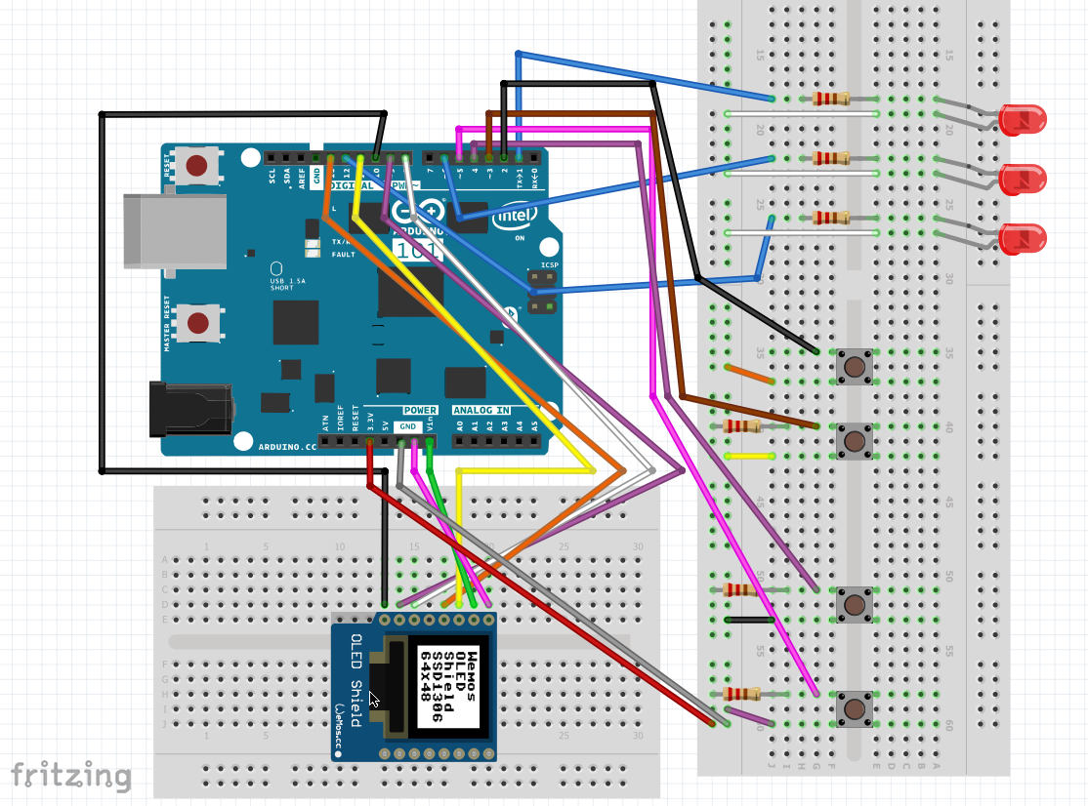
Wiring Diagram

Slide 4
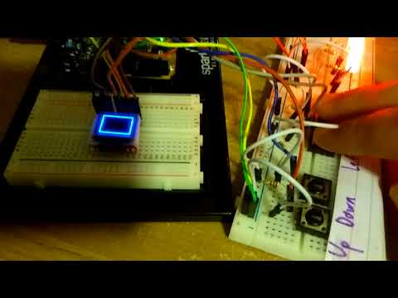
How it works:

Slide 5
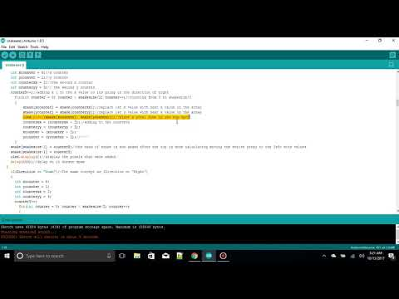

Code Walk through

